Slide 1
Vue.js and micro-frontends
Behind the scenes

Slide 2
Summary
Micro-frontends - a definition
Why micro-frontends?
Examples of micro-frontends in Vue.js
Coming soon

Slide 3
MICRO-FRONTENDS - A DEFINITION

Slide 4

In a nutshell...
My website
My website
MFE 1*
MFE 2
MFE 3
https://martinfowler.com/articles/micro-frontends.html
*MFE = Micro-frontend
Notes:
Monolith

Slide 5

Micro-frontends vs modules vs components
Component A
Component C
CSS
State management
Component B
Interface to the container app

Slide 6
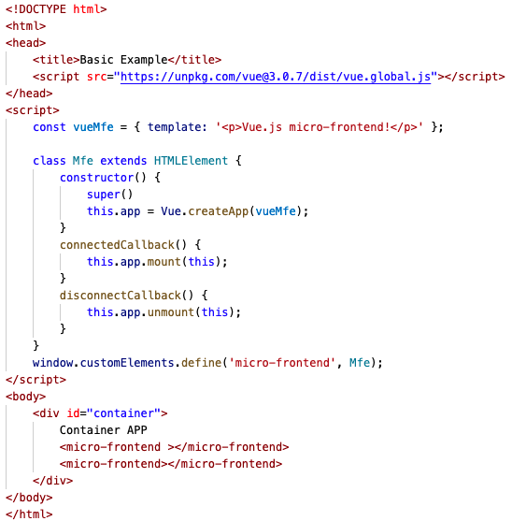
Example

Slide 7
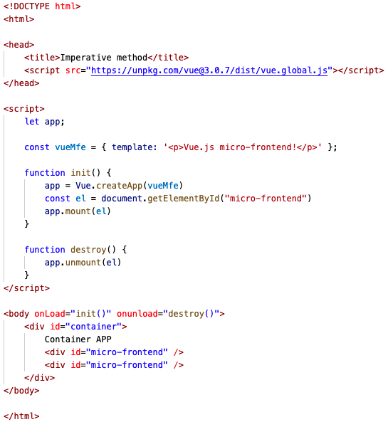
Other methods
“Imperative” approach
Iframes
Frameworks
https://martinfowler.com/articles/micro-frontends.html

Slide 8
WHY?

Slide 9
Reuse of functionalities
My website
My website
MFE 1
MFE 2
MFE 3
MFE 1
MFE 2
MFE 3
My website 2
My website 2
MFE 1’
MFE 4
MFE 5
MFE 1
MFE 4
MFE 5

Slide 10

Scalability
My website
My website
MFE 1
MFE 2
MFE 3
MFE N
...
Monolith
With micro-frontends

Slide 11
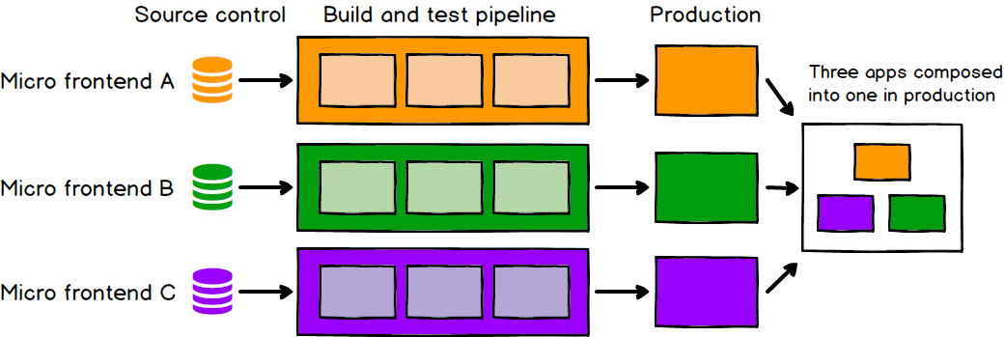
Workflow

Slide 12
Organization Structure
Team 1
Team 1
Team 2
Team 3
Team 1
Team 2
Team 3
Frontend
Frontend
MFE 1
MFE 2
MFE 3
Team 2
Micro-
Service 1
Micro-
Service
2
Micro-
Service
3
Micro-
Service
1
Micro-
Service
2
Micro-
Service
3
BACKEND

Slide 13
Technology agnostic
Component A
Component C
CSS
State management
Component B
Interface to the container app

Slide 14
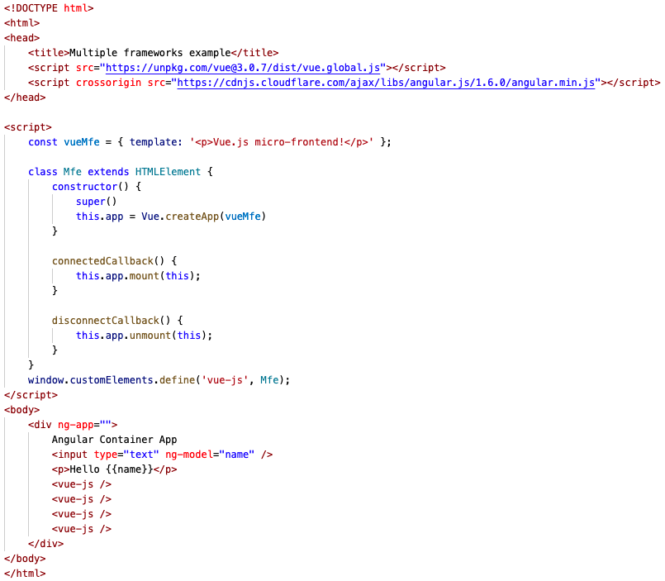
Example

Slide 15
Examples

Slide 16
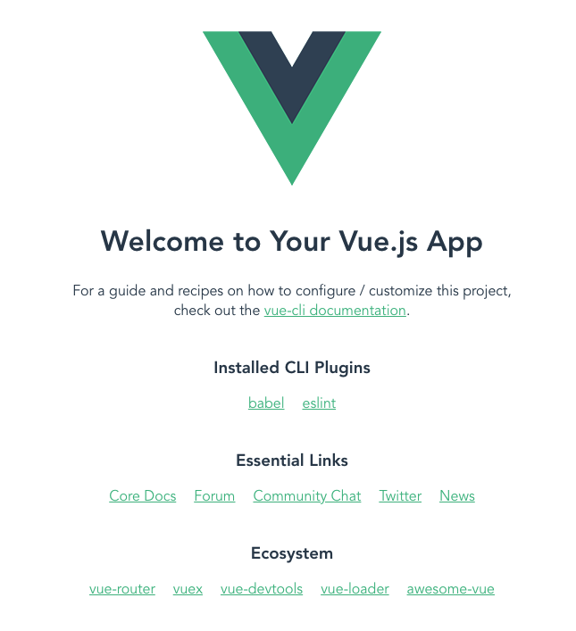
Example
vue create hello-world
Container Application

Slide 17
Vue 3.0

Slide 18
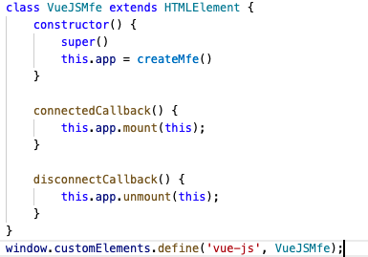
Vue 3.0
1.
hello-world/src/main.js
2.
vue-cli-service build --target lib --inline-vue './src/main.js'
3.
(sideEffect: true)

Slide 19
a few tips!

Slide 20
No CDN
Micro-frontend 1
Micro-frontend 2
Webpack (port 8080)
Webpack (port 8081)
Micro-frontend 3
Webpack (port 8082)
webpack
(8000)
MainApp
(index.html)

Slide 21
With CDN
Micro-frontend 1
CDN
Micro-frontend 2
Webpack (port 8082)
Micro-frontend 3
webpack
(8000)
MainApp
(index.html)

Slide 22
Manifest.json (webpack-manifest-plugin)
Micro-frontend
GET manifest.json
{
file1: bundle.js,
file2: chunk_1.js,
file3: chunk_2.js
}
manifest.json
for (/* each file in manifest.json */) {
var s = document.createElement("script");
s.src = ...;
document.head.appendChild(s);
}
GET bundle.js
GET chunk_1.js
GET chunk_2.js
chunk_1.js
bundle.js
chunk_2.js

Slide 23
Common dependencies
vue.config.js
module.exports = {
chainWebpack: config => {
config.externals({
'commonlib': 'commonlib'
})
}
}
Container app
Micro-frontend 1
Micro-frontend 2
Micro-frontend 3
Library of common utilities (javascript/CSS/plain components)
vue create commonlib
vue-cli-service build --target lib --name commonlib

Slide 24
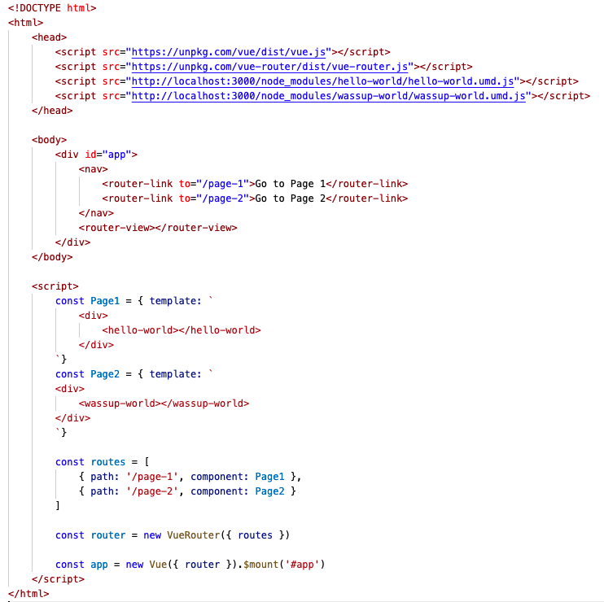
Routing

Slide 25
Vue 2.0

Slide 26

Vue 2.0 global APIs
Micro-frontend 1
Micro-frontend 2
Micro-frontend 1
Micro-frontend 2
new Vue(Component);
Vue.component(Component);
Vue.mixin(myMixing);
new Vue(Component);
Vue.component(Component);
Vue.mixin(myMixing);
new Vue(Component);
Vue.component(Component);
Vue.mixin(myMixing);
new Vue(Component);
Vue.component(Component);
Vue.mixin(myMixing);
vue-cli-service build --target lib --inline-vue './src/main.js'

Slide 27
Vue-cli
Leverage vue-cli to automatically generate the custom-element definition for us
vue-cli-service build --target wc --inline-vue './src/Hello-World.vue'
FYI, there is also a utility that does the same: https://www.npmjs.com/package/@vue/web-component-wrapper

Slide 28
Coming soon...

Slide 29
Webpack 5
Webpack 5 adds module federation to allow easy build of distributed frontends applications
Vue-cli has not yet officially released version 5.0 (which includes webpack 5)
You can however use the alpha/beta version of it
"devDependencies": {
"@vue/cli": "^5.0.0-alpha.8",
"@vue/cli-plugin-babel": "^5.0.0-alpha.8",
"@vue/cli-plugin-eslint": "^5.0.0-alpha.8",
"@vue/cli-service": "^5.0.0-alpha.8",
"@vue/compiler-sfc": "^3.0.0",
"babel-eslint": "^10.1.0",
"eslint": "^7.23.0",
"eslint-plugin-vue": "^7.0.0"
},
hello-world/package.json

Slide 30
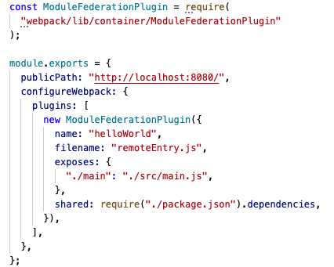
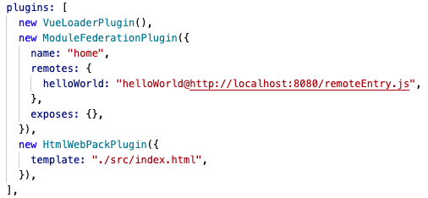
Webpack 5 - build config
hello-world/vue.config.js
main-app/webpack.config.js
...
...

Slide 31
Webpack 5 - main app config
main-app/src/index.js
import("helloWorld/main");

Slide 32
Thank you very much!
Github:
https://github.com/justadev1/geekle-vuejs

Slide 33
Additional Tips

Slide 34
Few tips...
Use npm link [mfe_name] command to make your local dependencies available to the CDN
Use concurrently [command_1] [command2] to simultaneously run multiple webpack processes/node servers at the same time
Use nodemon [command] to recompile your library on file chance

Slide 35
Communication among micro-frontends
You can use:
Html attributes
Event bus
Any state management tool
commonlib/index.js
Main app
import Emitter from 'tiny-emitter'
export default (new Emitter)
Micro-frontend 1
Micro-frontend 2
Micro-frontend 3
Library of common utilities (javascript/CSS/plain components)

Slide 36
Migrating legacy apps
Legacy app
Big Bang release!
New app
Legacy app
New app
New MFE
New MFE
New MFE

